Slide 1


正威国际集团调研报告
信息化部 张磊

Slide 2


报告概述
01
集团简介及发展历程
02
创始人王文银简介
03
集团业务介绍
04
经营状况和财务状况
05
集团未来计划及愿景

Slide 3

01
正威国际集团简介及发展历程
历时20多年, 实现从0到3300亿的蜕变

Slide 4
正威国际集团简介
世界铜王的铜业帝国
正威国际集团是由产业经济发展起来的一家以金属新材料和非金属新材料完整产业链为主导的高科技产业集团， 近年来大力发展产业投资与科技智慧园区开发、战略投资与财务投资、交易平台等业务，在金属新材料领域位列世界第一。
01
03
05
正威国际集团拥有员工超过17850名，总部位于广东省深圳市，应全球化业务发展， 在国内成立了华东、北方、西南、西北总部，在新加坡、瑞士和美国设有国际总部。
集团从2013年开始连续5年进入《财富》杂志发布的世界500强排行榜。在2017年8月全球制造商集团发布的《全球制造500强》中排名有色金属行业企业第二位。
2017年6月18日上午，正威国际集团北方总部在天津市西青区揭牌成立。项目投资超过200亿，包括北方总部基地、新材料生产基地、国际创新基地和生活服务基地四大板块。
历经20多年的发展，正威国际集团实现了从区域的、单一行业到世界的、全产业链的发展格局。充分体现了其专注产业链经营的企业愿景。
正威国际集团旗下拥有超过24个产业园区，并在瑞士、美国和新加坡设有研发中心。在2015年成立了正威大学，重视人才的培养和提高。.
02
04

Slide 5
发展历程
1995-2007
正威国际集团注册成立
王文银在整合了几家工厂的资源之后，在香港注册成立了正威国际集团。
全威（铜陵）铜业科技有限公司成立，安徽铜陵铜制造产业园建立
标志着正威国际集团完成了有色金属全产业链整合。
1995
2005
2007
1999
2007
香港携威实业有限公司注册成立
以贸易及OEM经营模式开始建立市场及经营格局的王文银在香港注册了自己的第一家公司，主要业务为买卖电源线。
江西赣州铜、钨采选冶及精深加工产业园
正威国际集团建立第一个自己的产业园区，奠定了有色金属全产业链发展之基。
创立AWIN国际集团
在新加坡成立第一家海外子公司，标志着正威国际集团开始进军海外市场。

Slide 6
发展历程
2008-2017
正威中华芯都半导体产业园和中国（营口）聚酰亚胺高新材料产业园动工
正威集团开始涉足国家重点扶持的以半导体和高新材料为代表的高新科技领域。
深圳正威健康产业投资有限公司成立、大健康产业园建立和深圳萨米国际医院项目签约
正威国际集团投资成立正威健康产业投资有限公司，并建立了大健康产业园，开始涉足大健康领域。10月28日，与德国汉诺威国际医学创新公司合作创立深圳萨米国际医院。
2008
2015
2017
2012
2015
收购安庆汉玉石材有限公司
标志着正威国际集团立志打造汉玉全产业链的决心。
金昌威电子有限公司年产3000万台智能手机项目下线
正威国际集团旗下全资子公司金昌威电子有限公司生产的智能手机通过与巴基斯坦和印度等海外市场的运营商合作，正式涉足智能手机领域。
正威国际集团北方总部落户天津西青区
6月18日，位于天津西青区的正威国际集团北方总部揭牌成立。北方总部项目投资200亿元，包括总部基地、新材料生产基地、国际创新基地和生活服务基地四大项目。

Slide 7

02
创始人王文银简介
2016年福布斯中国富豪榜第六位，低调的世界铜王

Slide 8
集团创始人、董事局主席王文银
安徽安庆人，博士学历学位
现任中国企业家协会副会长
深圳市政委常委
广东省工商联副主席
安徽省工商联副主席
深圳市工商联副主席
广东省安徽商会创会会长

Slide 9
低调的世界铜王的独到之处
2017年福布斯全球财富排行榜第79位，身家超过140亿美元。
危机中逆势抄底
97年亚洲金融风暴，囤房屯设备
03年非典疯狂买矿，杀入产业上游
08年全球金融危机，并购欧美铜加工企业购入几十万吨现货铜
追求极致的产品逻辑
把产品做成“毒品”，让客户上瘾。这就是王文银执着于极致的硬功夫。人们只认识冠军， 没人会记住第二名。
逆向打造全产业链
从插头到电线电缆开始逆势争上游
从矿山到铜板、再到精铜制造，正威完成了铜产业链的全布局，实现效益稳步提升。
独特五差赚钱法
根据铜业行业的特点， 王文银总结了五差赚钱法，即时间差、利率差、汇率差、积差和价差。

Slide 10

03
正威国际集团业务介绍
专注打造全产业链经营，成为全球卓越企业

Slide 11
正威国际集团七大产业分布
从传统制造到高分子新材料，从半导体到智能终端，从交易中心到无人机，展示了正威集团世界化的、全产业链的发展格局
大健康
医疗事业、养生养老、教育培训、科研、低氘水项目
大文化
以汉玉、红木和园艺为根基的文化创意、文化旅游、文化传媒、文化产业园区开发
高端装备制造
地质勘测、气象探测、通信中继、农药喷洒等民用无人机
侦查、情报收集、跟踪、通讯等军用产品
非金属新材料产业
以聚酰亚胺为主导的完整产业链和多元化产业群体
半导体和智能终端产业
半导体：IC设计、晶圆制造、封装测试、整机产品
电子信息：电子材料、线路板、产品制造
金属新材料产业
矿产业、铜加工、铜精深加工和铜贸易
大宗商品交易中心
上海、香港、日内瓦和新加坡四个贸易平台，以及国内三个交易中心

Slide 12
有色金属全产业链业务模式
有色金属是工业上对金属的一种分类，指除铁、铬、锰之外，存在于自然界中的金属。
正威国际集团是以铜业起家的，经过20多年的努力，已经形成了有色金属的全产业链业务模式。通常情况下，企业都是沿着产业链条自上而下展开延伸的，而王文银的正威国际集团恰恰相反，走出了一条自下而上的“逆袭之路”。因此他常常戏称自己是把“插头”做到“石头”的第一人。
矿区开采
正威国际集团在全球投资了十多个矿山，集团旗下的江西赣州铜、钨采选冶及精深加工产业园可年处理矿石超过33万吨。
铜矿冶炼加工
集团旗下全威铜业和多个产业园区可以年产超过50万吨的低氧光亮铜杆，实现从矿山到铜板铜杆的产业下游整合。
精深加工
旗下宏威高新材料有限公司的挠性覆铜板生产项目落户四川广安，24条生产线，年产3000万平方米的生产规模，占领全球15%的高端挠性覆铜板市场，实现年产值超过26亿元
贸易平台
金属新材料的全产业链虽然形成，但是金属新材料的生产销售利润很低，河南金属交易中心、贵州国际商品交易中心和湖南国际矿产资源交易中心以及上海、香港、日内瓦和新加坡四大贸易平台的建立，完善了正威的铜业全产业链模式。

Slide 13
大宗商品贸易中心
全产业链中获得定价权的重要一环
正威国际集团贸易中心
金属新材料的生产销售利润很低，正威要想在全球金属新材料产业上拥有绝对话语权，还需要搭建贸易中心。这些贸易中心既可以为集团原材料采购提供保证，同时也能接触国际市场的巨头，为公司下一步投资提供便利。目前，正威旗下拥有贵州国际商品交易中心，河南金属交易中心，湖南国际矿产资源交易中心，以及上海、香港、日内瓦、新加坡四大贸易平台，标志着正威国际集团贸易体系布局完成。
贵州国际商品交易中心，是贵州省政府批准的大宗商品现货交易市场重点扶持项目。有正威集团和贵州双龙航空港产业投资有限公司联合发起设立。交易中心按照批文进行现货交易，不得进行证券、保险、信贷、黄金等业务，不得做金融融资交易。
01
01
02
03
02
河南金属交易中心是由洛阳市人民政府与正威集团共同投资设立的国际化、综合化商品交易平台，注册资金1亿元。交易品种涵盖有色金属铜、铝、钼为主的国际、国内各类大宗商品。
03
湖南国际矿产资源交易中心是有正威集团与郴州高科投资控股有限公司共同发起设立的专注于有色金属全产业链服务的产业互联网平台型企业。两大产业分别是以白银为代表的稀贵金属全产业链和以矿物晶体为代表的宝玉石产业。

Slide 14


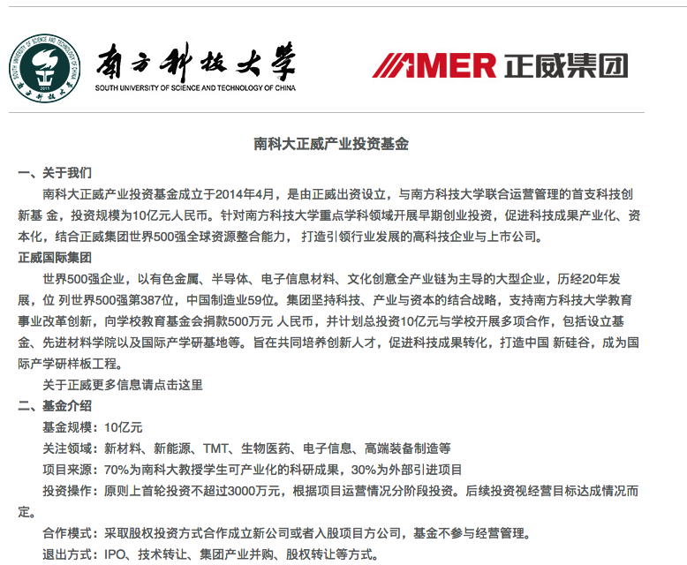
正威集团南科大产业投资基金
南科大正威产业投资基金
2014年4月，正威集团出资，与南方科技大学联合运营管理的首支科技创新基金设立，投资规模为10亿元人民币。针对南方科技大学重点学科领域开展早期创业投资，促进科技成果产业化、资本化。
关注领域为新材料、新能源、TMT、生物医药、电子信息和高端装备制造等。70%为南科大教授学生可产业化的科研成果，30%为外部引进项目。
Notes:
http://www.sustcef.org/cn/cooperation/intro/

Slide 15
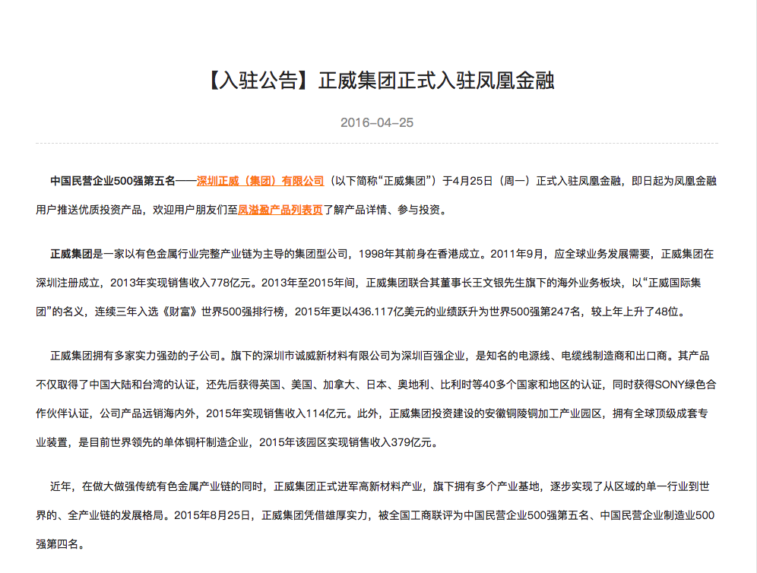
正威集团入驻凤凰金融
正威集团入驻凤凰金融 涉足金融投资领域
2016年4月25日，凤凰金融发布入驻公告。公告显示深圳正威（集团）有限公司于4月25日正式入驻凤凰金融，即日起为凤凰金融用户推送优质投资产品。
根据凤凰金融网站的介绍显示，正威集团与凤凰金融合作的主要方式为正威集团为向凤凰金融用户提供理财产品和提供投资保障。
Notes:
https://www.fengjr.com/cn/news/detail/92A402AE-974F-4F65-88E8-3D3C8717D68C

Slide 16
WRITE YOUR GREAT TITLE HERE
This is a good space for a short subtitle
Option 01
We have many PowerPoint templates that has been specifically designed.
Option 03
We have many PowerPoint templates that has been specifically designed.
Option 02
We have many PowerPoint templates that has been specifically designed.
Option 04
We have many PowerPoint templates that has been specifically designed.

Slide 17
WRITE YOUR GREAT TITLE HERE
This is a good space for a short subtitle
We have many PowerPoint templates that has been specifically designed to help anyone that is stepping into the world of PowerPoint for the very first time. We have many PowerPoint templates that has been specifically designed to help anyone that is stepping into the world of PowerPoint for the very first time.
TOPIC HEADER ONE
We have many PowerPoint templates that has been specifically designed.
TOPIC HEADER TWO
We have many PowerPoint templates that has been specifically designed.
TOPIC HEADER THREE
We have many PowerPoint templates that has been specifically designed.
TOPIC HEADER FOUR
We have many PowerPoint templates that has been specifically designed.

Slide 18
WRITE YOUR GREAT TITLE HERE
This is a good space for a short subtitle
WHAT MAKES US DIFFERENT ？
We have many PowerPoint templates that has been specifically designed to help anyone that is stepping into the world of PowerPoint for the very first time. We have many PowerPoint templates that has been specifically designed to help anyone that is stepping into the world of PowerPoint for the very first time. We have many PowerPoint templates that has been specifically designed to help anyone that is stepping into the world of PowerPoint for the very first time.
01
01
We have many PowerPoint templates that has been specifically designed to help anyone that is stepping into the world of PowerPoint for the very first time.
02
03
02
We have many PowerPoint templates that has been specifically designed to help anyone that is stepping into the world of PowerPoint for the very first time.
03
We have many PowerPoint templates that has been specifically designed to help anyone that is stepping into the world of PowerPoint for the very first time.
Marketing
Creative

Slide 19
WRITE YOUR GREAT TITLE HERE
This is a good space for a short subtitle
WHAT MAKES US DIFFERENT ？
We have many PowerPoint templates that has been specifically designed to help anyone that is stepping into the world of PowerPoint for the very first time. We have many PowerPoint templates that has been specifically designed to help anyone that is stepping into the world of PowerPoint for the very first time. We have many PowerPoint templates that has been specifically designed to help anyone that is stepping into the world of PowerPoint for the very first time.
OPTION 01
OPTION 02
OPTION 03
Marketing
Creative
Message
Management
OPTION 04
We have many PowerPoint templates that has been specifically designed to help anyone that is stepping into the world of PowerPoint for the very first time. We have many PowerPoint templates that has been specifically designed to help anyone that is stepping into the world of PowerPoint for the very first time.
OPTION 05

Slide 20
WRITE YOUR GREAT TITLE HERE
This is a good space for a short subtitle
TOPIC HEADER TWO
We have many PowerPoint templates that has been specifically designed.
TOPIC HEADER ONE
We have many PowerPoint templates that has been specifically designed.
TOPIC HEADER THREE
We have many PowerPoint templates that has been specifically designed.

Slide 21
03
Insert Header Topic Here
We have many PowerPoint templates that has been specifically designed to help anyone that is stepping into the world of PowerPoint for the very first time.

Slide 22








WRITE YOUR GREAT TITLE HERE
This is a good space for a short subtitle
WHAT MAKES US DIFFERENT?
We have many PowerPoint templates that has been specifically designed to help anyone that is stepping into the world of PowerPoint for the very first time. We have many PowerPoint templates that has been specifically designed to help anyone that is stepping into the world of PowerPoint for the very first time.
Insert Header Topic Here
MARKETING TEAM
We have many PowerPoint templates that has been specifically designed to help anyone that is stepping into the world of PowerPoint for the very first time. We have many PowerPoint templates that has been specifically designed to help anyone that is stepping into the world of PowerPoint for the very first time.

Slide 23

WRITE YOUR GREAT TITLE HERE
This is a good space for a short subtitle
WRITE YOUR GREAT TITLE HERE
We have many PowerPoint templates that has been specifically designed to help anyone that is stepping into the world of PowerPoint for the very first time. We have many PowerPoint templates that has been specifically designed to help anyone that is stepping into the world of PowerPoint for the very first time.
We have many PowerPoint templates that has been specifically designed to help anyone that is stepping into the world of PowerPoint for the very first time. We have many PowerPoint templates that has been specifically designed to help anyone that is stepping into the world of PowerPoint for the very first time.

Slide 24



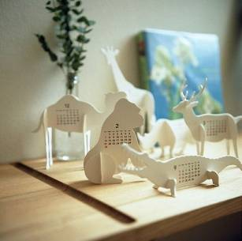
WRITE YOUR GREAT TITLE HERE
This is a good space for a short subtitle
HEAD INFO HERE
We have many PowerPoint templates that has been specifically designed.
HEAD INFO HERE
We have many PowerPoint templates that has been specifically designed.
01
03
02
04
HEAD INFO HERE
We have many PowerPoint templates that has been specifically designed.
HEAD INFO HERE
We have many PowerPoint templates that has been specifically designed.

Slide 25
WRITE YOUR GREAT TITLE HERE
This is a good space for a short subtitle
TOPIC HEADER ONE
We have many PowerPoint templates that has been specifically designed to help anyone that is stepping into the world of PowerPoint for the very first time.
TOPIC HEADER TWO
We have many PowerPoint templates that has been specifically designed to help anyone that is stepping into the world of PowerPoint for the very first time.
TOPIC HEADER THREE
We have many PowerPoint templates that has been specifically designed to help anyone that is stepping into the world of PowerPoint for the very first time.
TOPIC HEADER FOUR
We have many PowerPoint templates that has been specifically designed to help anyone that is stepping into the world of PowerPoint for the very first time.

Slide 26

04
Insert Header Topic Here
We have many PowerPoint templates that has been specifically designed to help anyone that is stepping into the world of PowerPoint for the very first time.

Slide 27




WRITE YOUR GREAT TITLE HERE
This is a good space for a short subtitle
TOPIC HEADER ONE
We have many PowerPoint templates that has been specifically designed to help anyone that is stepping into the world of PowerPoint for the very first time.
TOPIC HEADER THREE
We have many PowerPoint templates that has been specifically designed to help anyone that is stepping into the world of PowerPoint for the very first time.
TOPIC HEADER TWO
We have many PowerPoint templates that has been specifically designed to help anyone that is stepping into the world of PowerPoint for the very first time.
TOPIC HEADER FOUR
We have many PowerPoint templates that has been specifically designed to help anyone that is stepping into the world of PowerPoint for the very first time.

Slide 28
WRITE YOUR GREAT TITLE HERE
This is a good space for a short subtitle
OPTION 01
We have many PowerPoint templates that has been specifically designed to help anyone that is stepping into the world of PowerPoint for the very first time.
OPTION 02
We have many PowerPoint templates that has been specifically designed to help anyone that is stepping into the world of PowerPoint for the very first time.
OPTION 03
We have many PowerPoint templates that has been specifically designed to help anyone that is stepping into the world of PowerPoint for the very first time.
OPTION 04
We have many PowerPoint templates that has been specifically designed to help anyone that is stepping into the world of PowerPoint for the very first time.

Slide 29




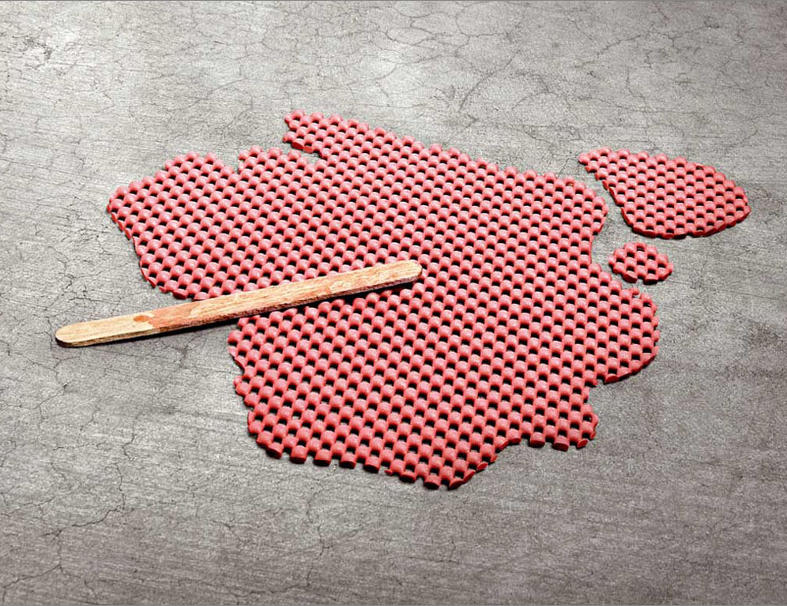
WRITE YOUR GREAT TITLE HERE
This is a good space for a short subtitle
OPTION 01
We have many PowerPoint templates that has been specifically designed.
OPTION 03
We have many PowerPoint templates that has been specifically designed.
OPTION 05
We have many PowerPoint templates that has been specifically designed.
OPTION 02
We have many PowerPoint templates that has been specifically designed.
OPTION 04
We have many PowerPoint templates that has been specifically designed.

Slide 30


WRITE YOUR GREAT TITLE HERE
This is a good space for a short subtitle
30%
We have many PowerPoint templates that has been specifically designed.
01
We have many PowerPoint templates that has been specifically designed.
02
We have many PowerPoint templates that has been specifically designed.
03
We have many PowerPoint templates that has been specifically designed.

Slide 31
THANKS FOR WATCHING
POWERPOINT TEMPLATE
We have many PowerPoint templates that has been specifically designed to help anyone that is stepping into the world of PowerPoint for the very first time.

Slide 32
600+
FOR FREE
颜色
自由更换
免费实用矢量图标

Slide 33
600+
FOR FREE
颜色
自由更换
免费实用矢量图标

